Slide 1
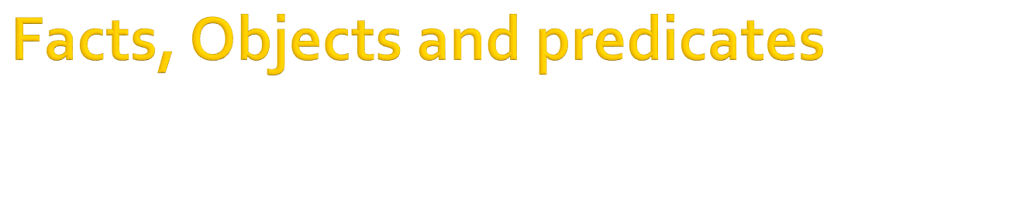
Chapter 3

Slide 2

With TP we can describe facts as symbolic relationship.
Def.: Fact is an assertion that is either true or false.
  Fact in English :“Right speaker is dead”
  Fact in TP: is(right_speaker, dead).
Factual expression in Prolog is called a clause. Clause ends with a period (.) sign.

Slide 3

is( right_speaker, dead ).
An object is the name of an element of a certain type.
Objects represents
  An entity (right_speaker)
  Or a property (dead) of an entity in real world
object

Slide 4

Prolog defines 6 types of object. “symbol” is one of them.
Naming convention for symbol type object:
  Always begins with lowercase letter.
  Remaining characters in the name can be upper/lower case letter, underscore ( _ ) or number
  Object name can be 1 to 250 character long.

Slide 5
Some valid symbol object:
  right_speaker
  dead
  jack
  automobile
  red
  age12

Slide 6
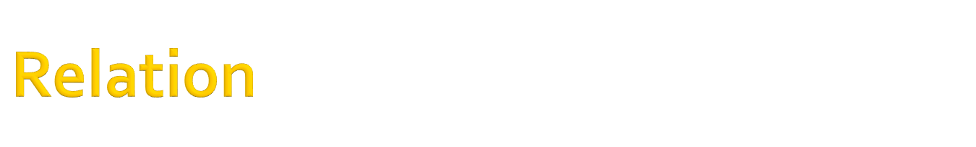
A relation is a name that defines the way in which a collection of objects (or objects and variables referring to objects ) interacts
Fact | Relation
has_a(bill, computer). | has_a
is_a(tommy, dog). | is_a
likes(sue, chocolates). | likes

Slide 7
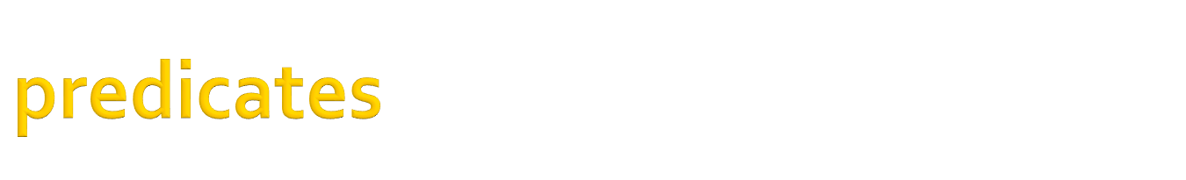
A predicate is a function with a value true or false
predicates expresses
  a property or
  a relationship
The entire expression before period (.) of a fact is called a predicate
has_a(bill, computer) .
predicate
Fact/clause

Slide 8
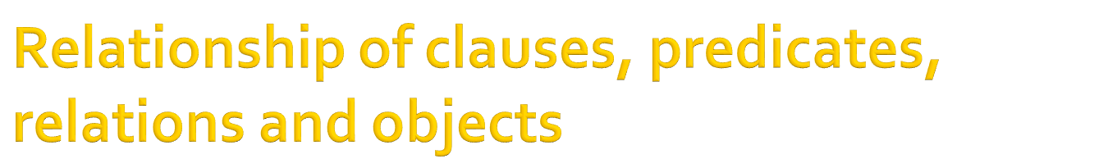
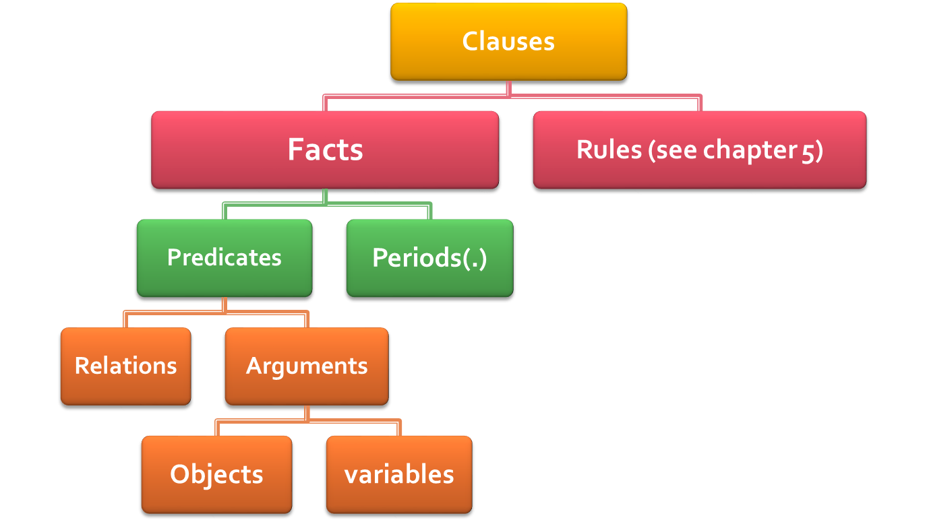

Slide 9
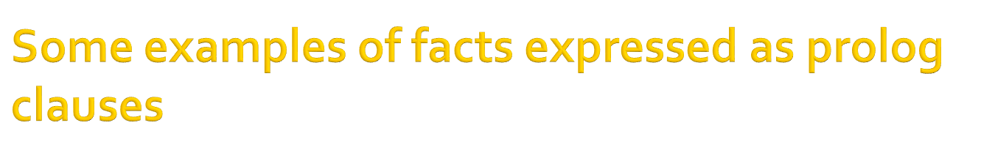
English: Bill is an employee.
Prolog : employee(bill).
English: Bob is married to Mary.
Prolog: married_to(bob,mary).
English: The speaker is defective.
Prolog: diagnosis(speaker,defective).
English: The speaker is defective.
Prolog: defective_speaker.
English: Bob likes automobile and computer.
Prolog: likes(bob,automobiles) and
likes(bob,computers).

Slide 10
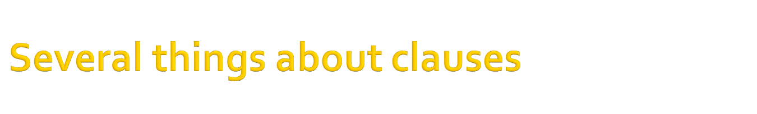
A given relation can have any number of object
A predicate can have any number of arguments including zero
Object can represent physical entity or abstract concept
Objects are always singular
Certain names are reserved for TP and should not be used for object name.

Slide 11

A TP program consists of two or more sections in order
  1. domains : defines the type of each object in a program
  2. predicates: defines the relations used in the clauses section. Contains no period (.)
  3. clauses: expressed facts and rules

Slide 12
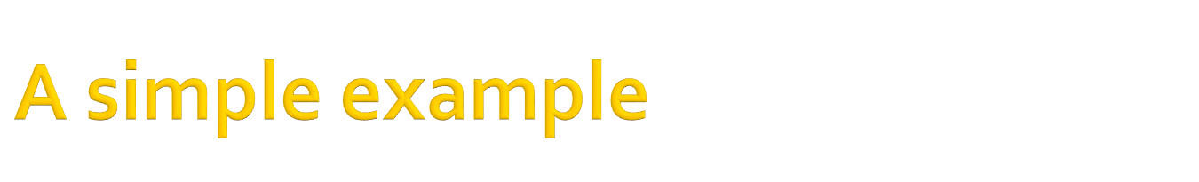
domains
diseases , indication=symbol
predicates
symptom(diseases , indication)
clauses
symptom( chicken_pox , high_fever).
symptom( chicken_pox, chills).
symptom( flu, chills).
symptom( cold, mild_boby_ache).
symptom( flu, severe_body_ache).
symptom( cold, runny_nose).
symptom( flu, runny_nose).
symptom( flu, moderate_cough).
Goal :symptom(cold, runny_nose)
True
Goal :
Goal :symptom(cold, headache)
False
Goal :

